Slide 1
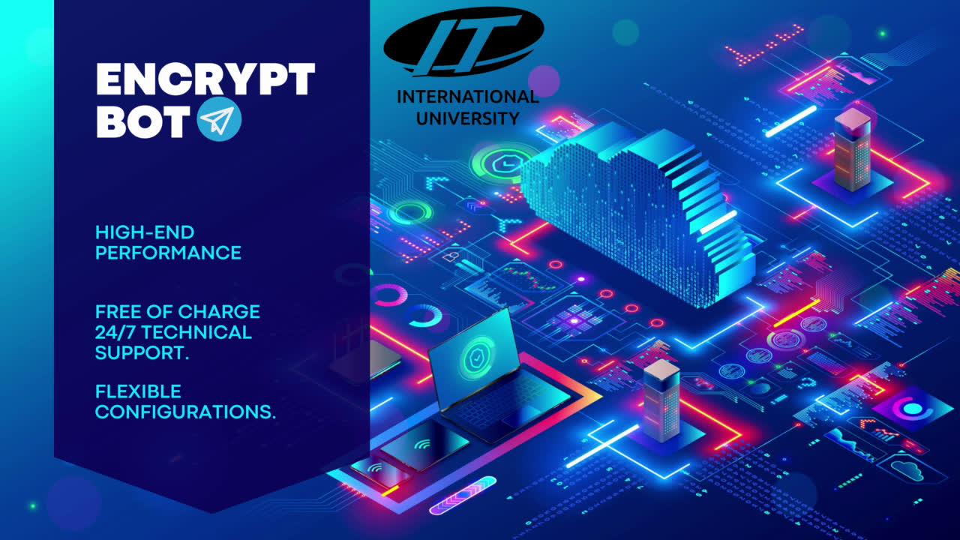

Slide 2


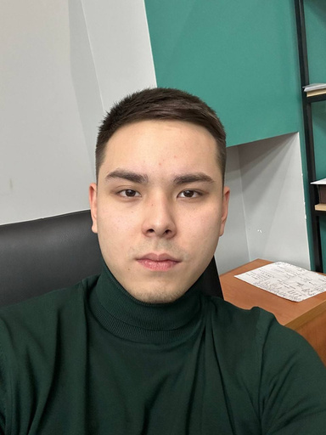
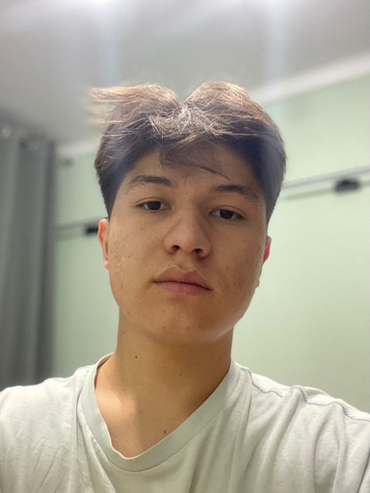
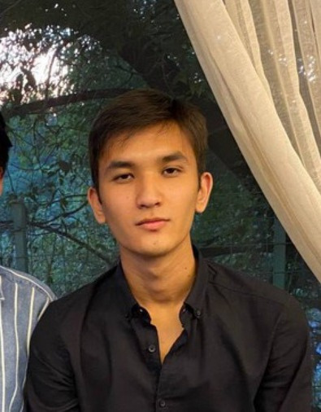
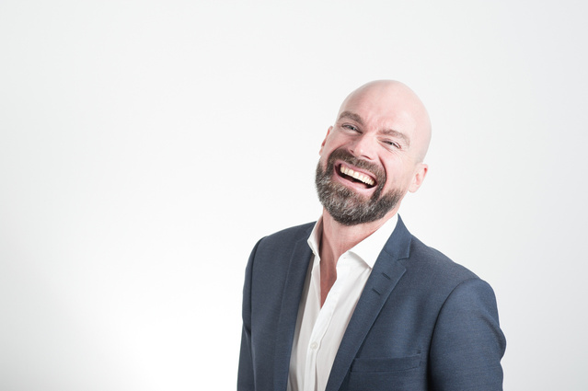
Our Team
Rakhmetuly Zhanserik
Amiruldayev Emil
Nurpeissov Daniyar
GROUP:SIS 2121
RESPONSIBILITIES IN PROJECT:
INTEGRATION ENCRYPT AND DECRYPT
:
GROUP:SIS 2121
RESPONSIBILITIES IN PROJECT:BOT CREATION AND SETUP
GROUP:SIS 2121
RESPONSIBILITIES IN PROJECT:
INTEGRATION DATA BASE

Slide 3
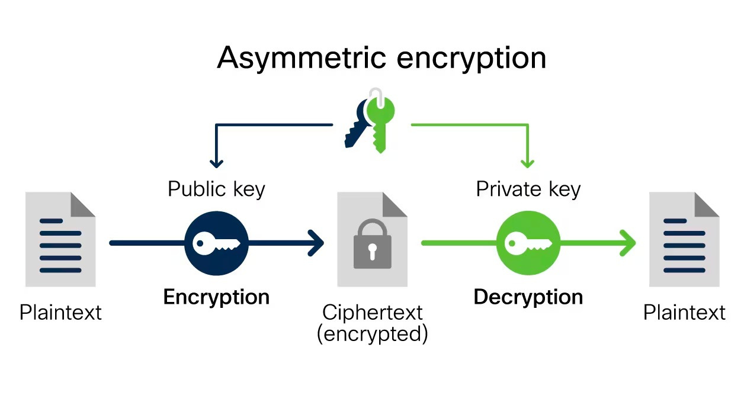

Encryption and Decryption
ENCRYPTION IS THE PROCESS BY WHICH A READABLE MESSAGE IS CONVERTED TO AN UNREADABLE FORM TO PREVENT UNAUTHORIZED PARTIES FROM READING IT. DECRYPTION IS THE PROCESS OF CONVERTING AN ENCRYPTED MESSAGE BACK TO ITS ORIGINAL (READABLE) FORMAT. THE ORIGINAL MESSAGE IS CALLED THE PLAINTEXT MESSAGE. THE ENCRYPTED MESSAGE IS CALLED THE CIPHERTEXT MESSAGE.

Slide 4
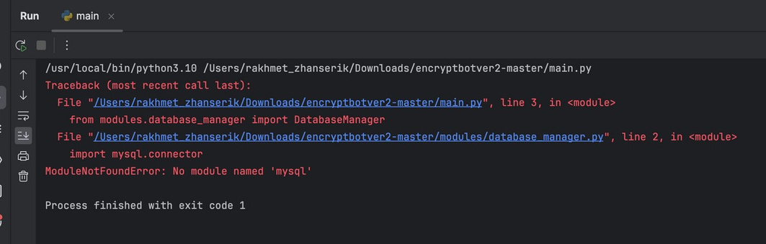

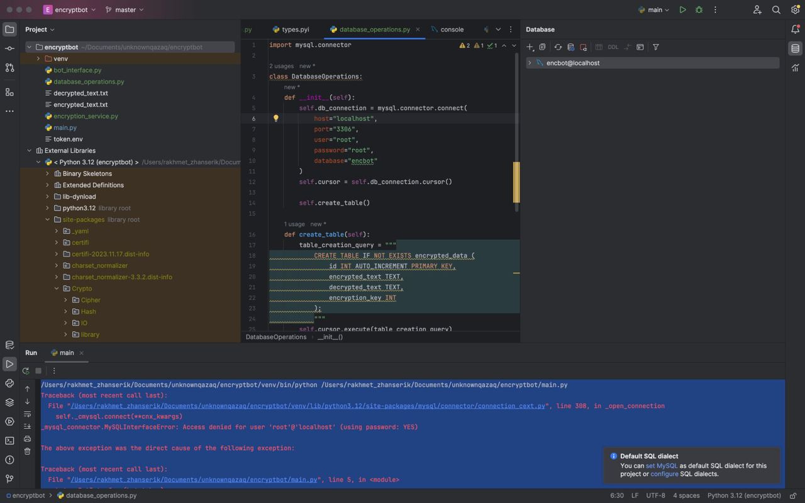


DURING THE PROJECT, THE FOLLOWING TASKS WERE COMPLETED:
1.Bot Creation and Setup
2.Encryption and Decryption Logic
3.Database Integration
CHALLENGES ENCOUNTERED:
1.Security Concerns
2.Error Handling and Validation
3.Database Management
APPROACHES USED TO RESOLVE CHALLENGES:
1.Thorough Research and Understanding:
2.Security-Centric Development:
3.Validation and Error Handling:

Slide 5
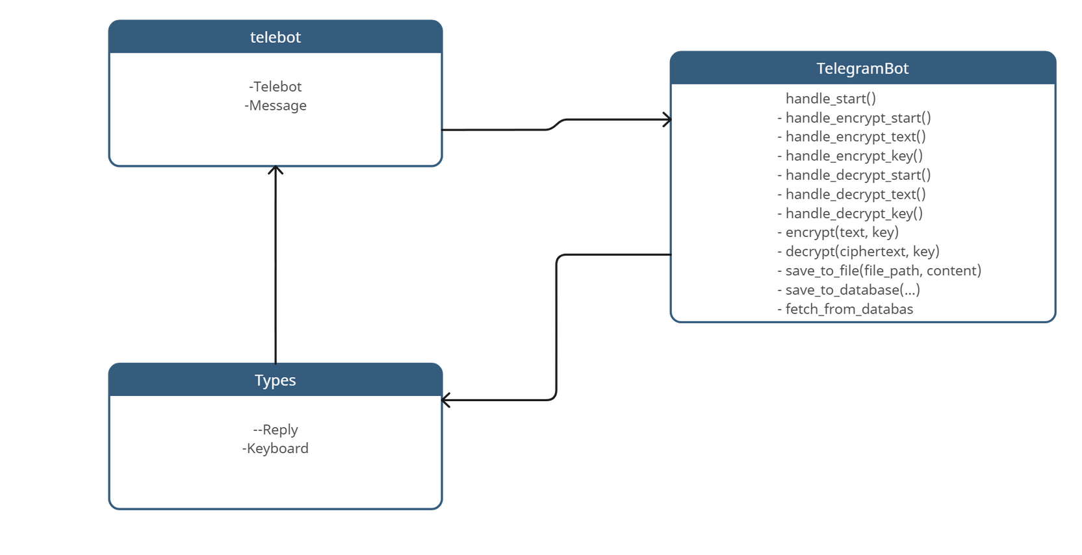
Class diagram

Slide 6
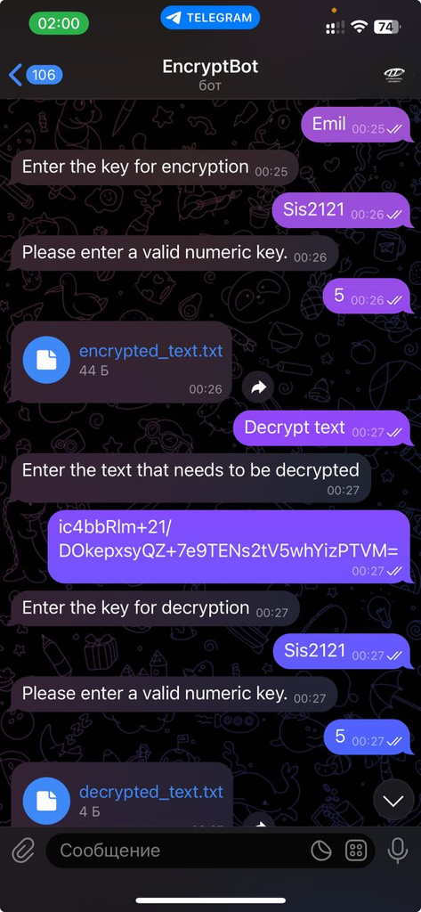
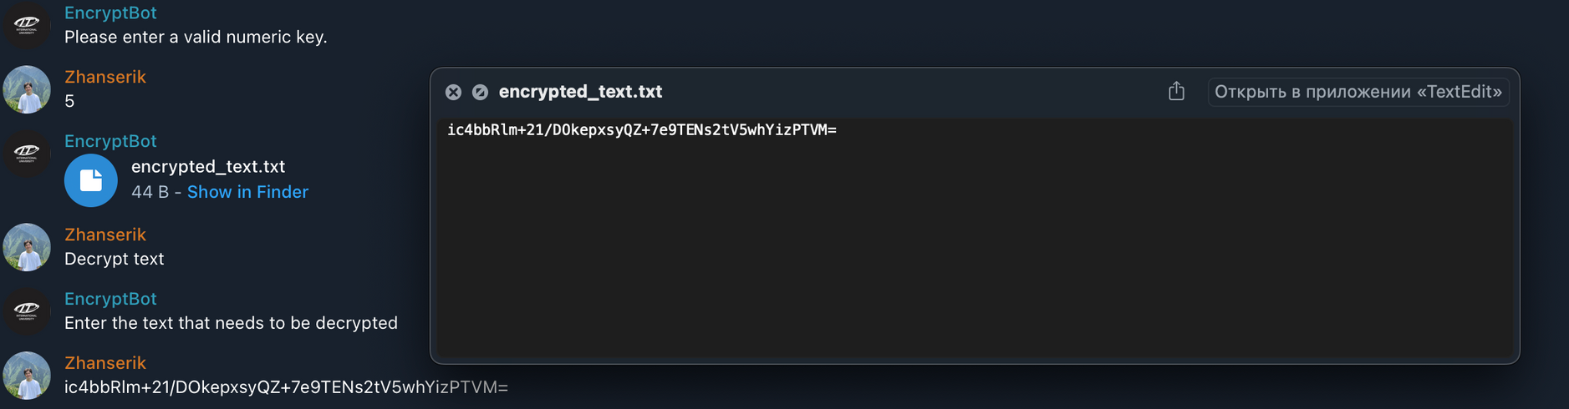
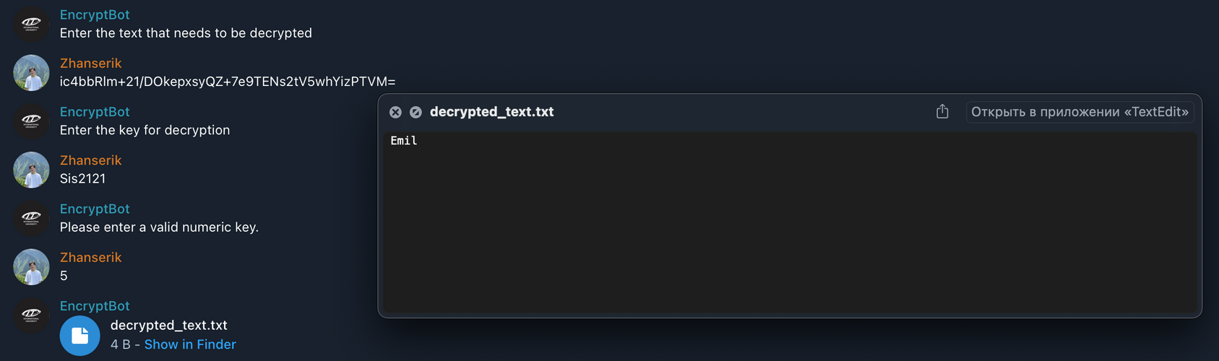
Activity diagram

Slide 7
Conclusion
Bot Development: We created a functional Telegram bot using Telebot library, implementing features to encrypt and decrypt text messages.
Encryption Logic: We incorporated encryption and decryption functionalities, ensuring data security using established encryption algorithms.
Database Integration: We seamlessly integrated a MySQL database, allowing us to store encrypted text alongside relevant information, enabling secure retrieval.
However, our journey wasn't without challenges. We faced several hurdles along the way:
Security Concerns: Implementing encryption securely while ensuring user data safety was a primary concern.
User Input Validation: Handling various user inputs for encryption keys and text required meticulous validation and error handling.
Performance Optimization: Ensuring the bot's performance and scalability as user traffic increased demanded careful optimization.

Slide 8
THANK
YOU

